Slide 1
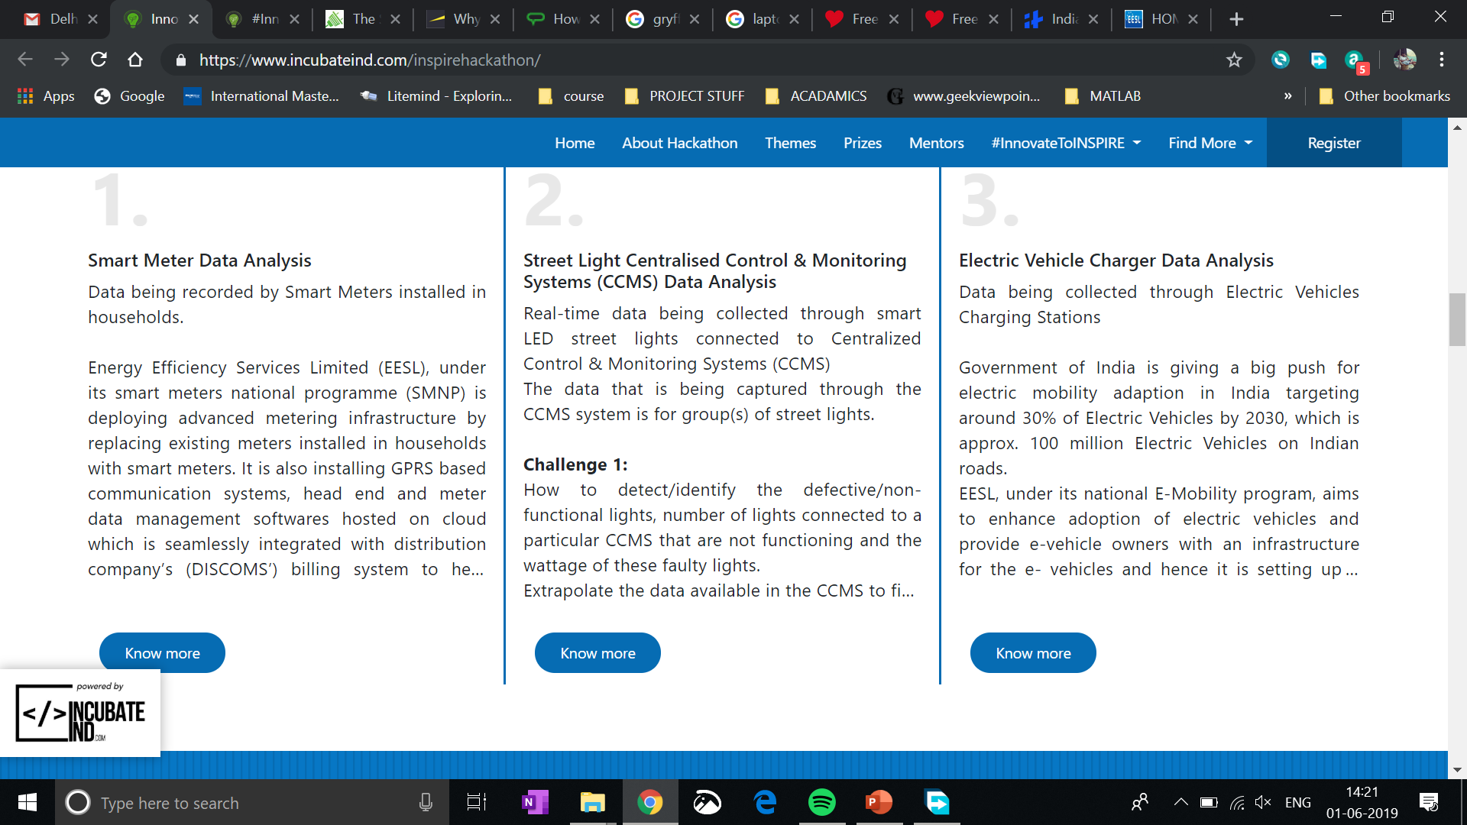

Slide 2

Gaurav
Garuddwar
Driving E-Mobility adoption
And solving the challenges that come for this economy.

Slide 3
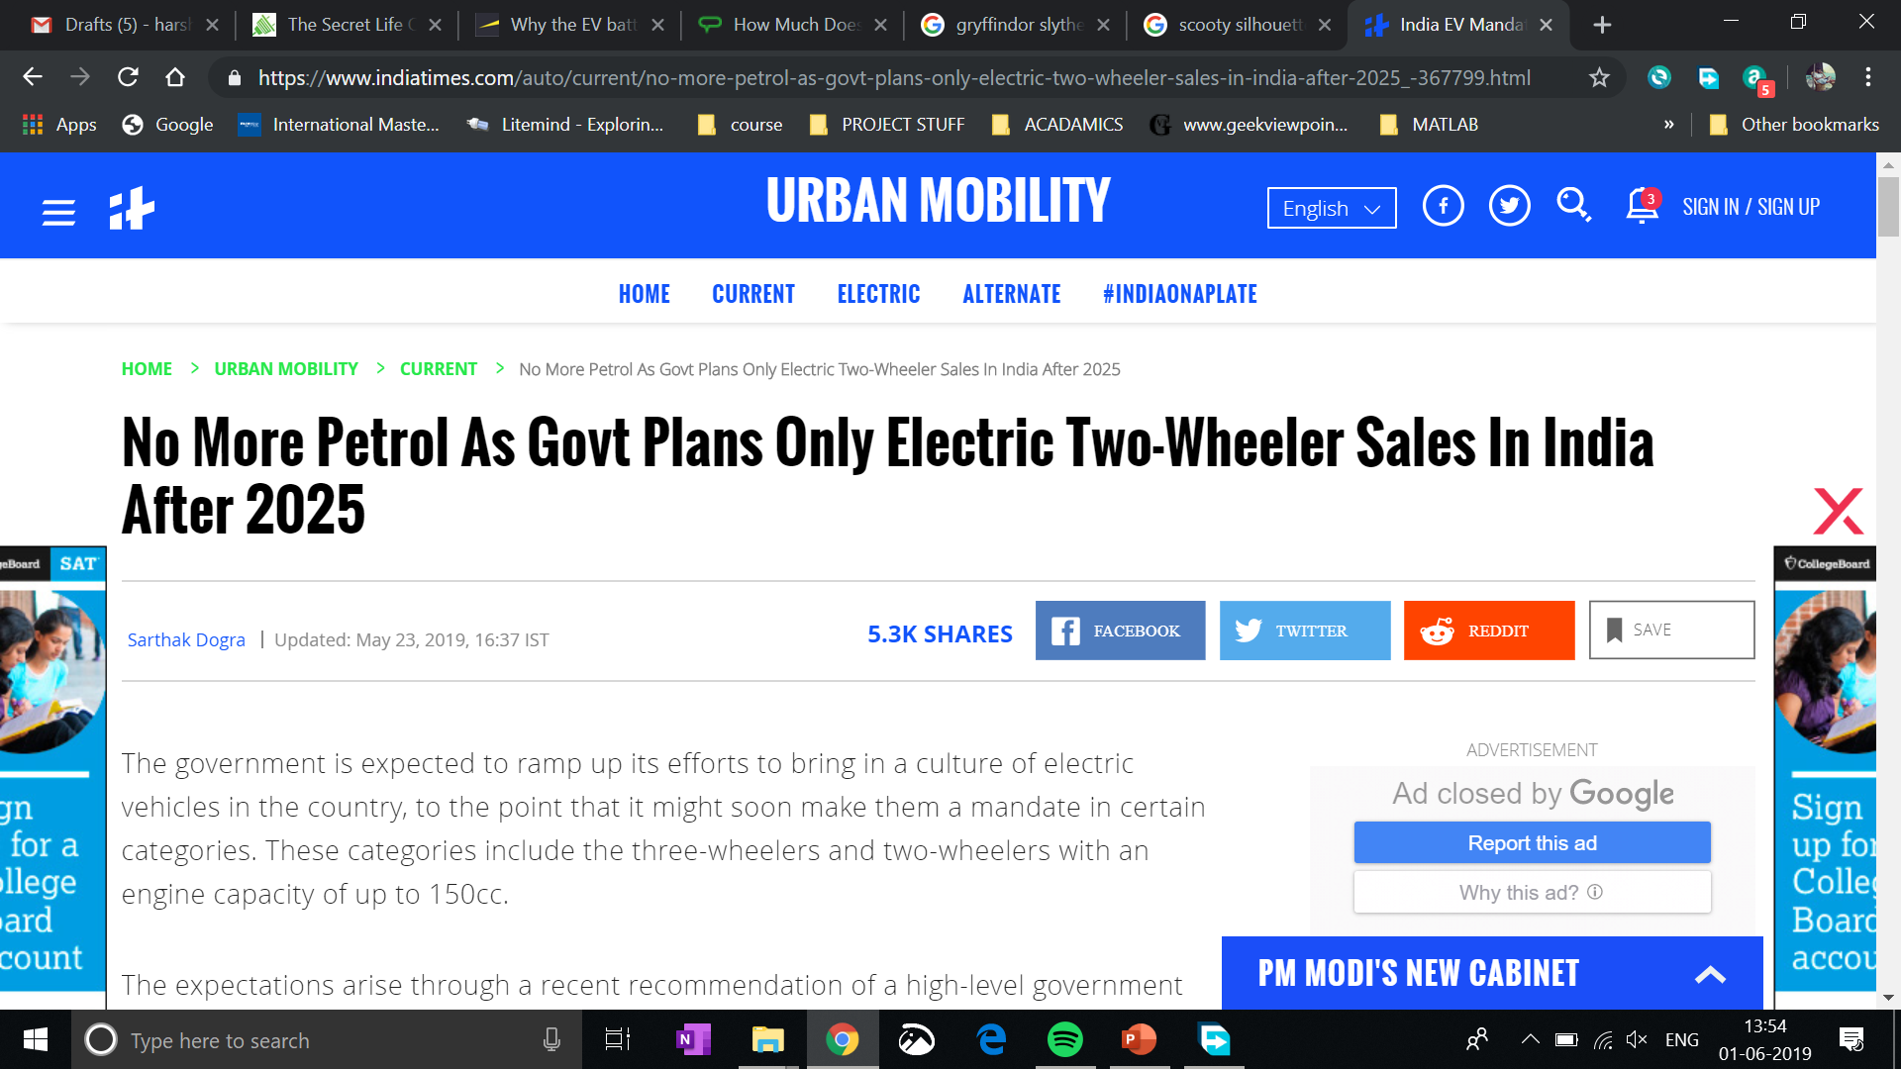
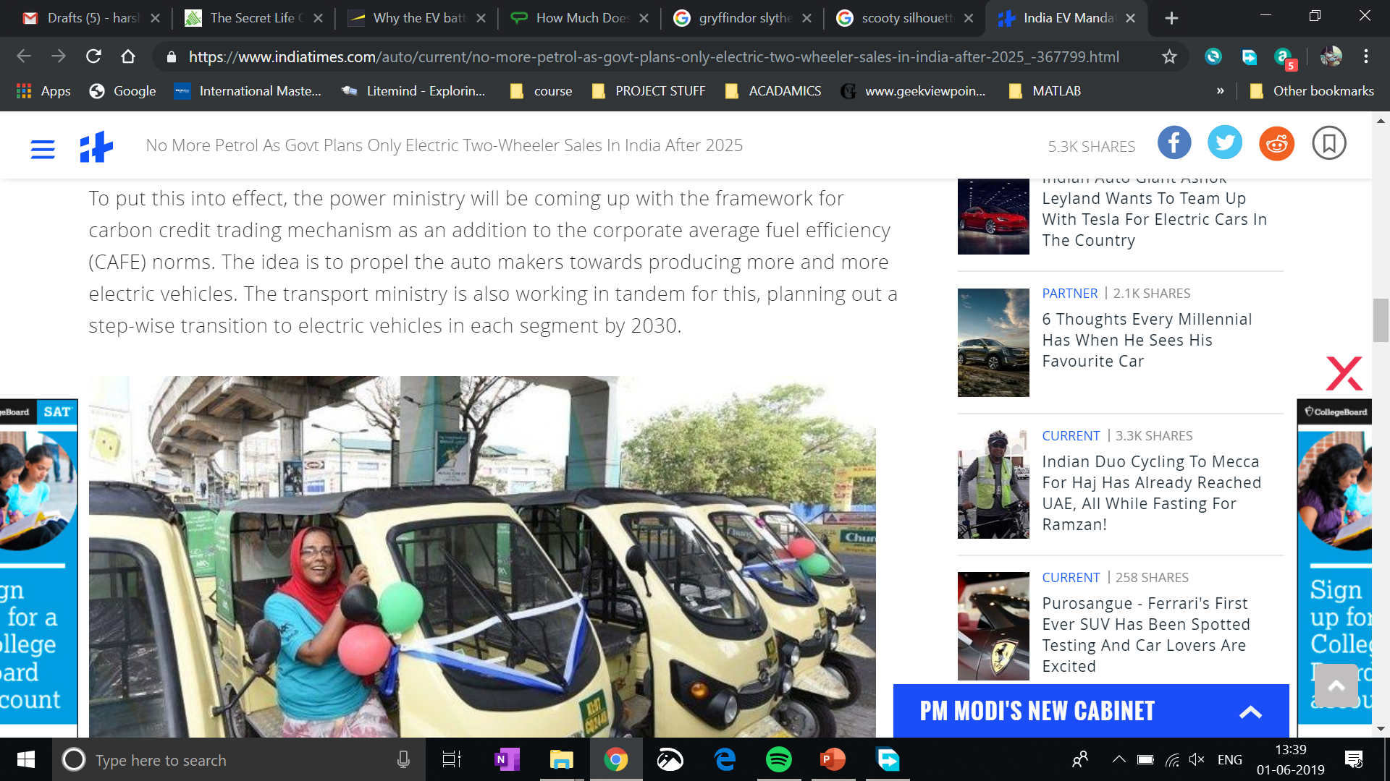

The move targets the two highest selling categories in the Indian automotive market, together counting to a total of over 2 crore units annually.
Source

Slide 4
But to get to that, there are many challenges waiting to be solved
And here is our solution …

Slide 5
1. Data aggregation
2. Adoption
3. Plumbing

Slide 6
Key Questions ?
What insights are most relevant ?
What data from Battery Management System (BMS) of EV matters?
How to calculate battery status ?
Zero charge
Threshold Charge limit
Recommended Charge limit
What is battery lifecycle ?
Calculation model
Average battery lifetime for present fleet
Fleet analytics
User profile
Location
Who needs what information the most ?
EESL
Consumers
Third parties
0. Mentors (Swati Sharma)
1. Data aggregation
2. Adoption

Slide 7
Gaurav
Garuddwar
Technology Solution

Slide 8

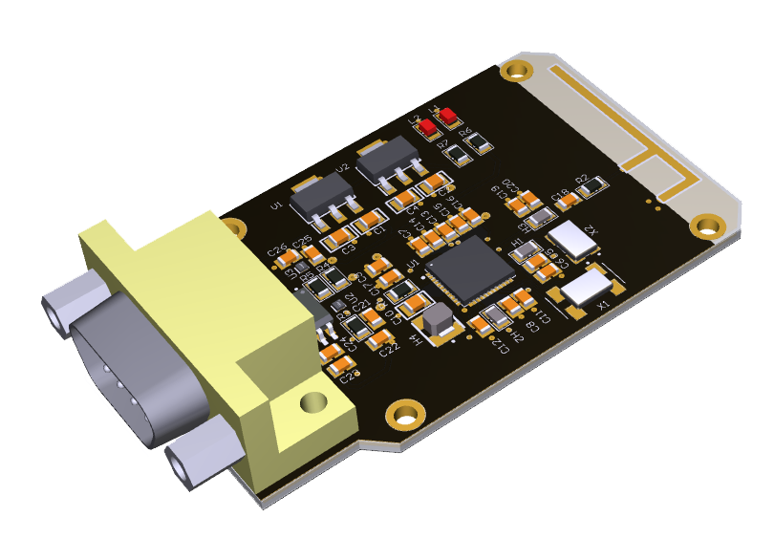

Gaurav
Garuddwar
Garud
Gaurav
Dwar
Technology Solution

Slide 9
Garud
Low cost device with CAN Protocol support
To access battery management system data of EV
In Realtime

Slide 10
Gaurav
Cross platform App
To access data from device
To access device location
To get user information
Push them all to server
Display analytics
Give battery charge info
Give battery life info
Navigation to EV Stations
And more …

Slide 11
Gaurav

Slide 12
Gaurav

Slide 13


Nationwide fleet of EV to hook-up (or even supply?) our device with.

Slide 14

Dwar
To drive analytics
Fleet monitoring
EV station placement
Position (Lat, Long)
Capacity & Distribution
Battery waste/lifecycle management
Dashboards & APIs for
EESL
Charging Stations
Analysts & Third Parties

Slide 15
Dwar

Slide 16
Dwar

Slide 17
Dwar

Slide 18




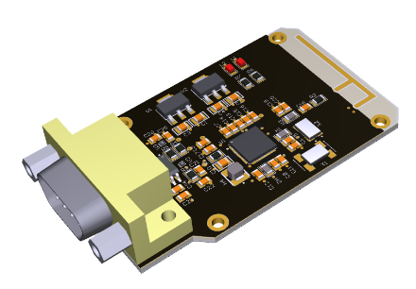


Garud
Insights
Analytics Engine
Display analytics
Give battery charge info
Give battery life info
Navigation to EV Stations
And more …
Dwar
Insights
Fleet monitoring
EV station placement
Position (Lat, Long)
Capacity & Distribution
Battery waste/lifecycle management
Garud
EVs
Data

Slide 19
Gaurav
Insights
Analytics Engine
Display analytics
Give battery charge info
Give battery life info
Navigation to EV Stations
And more …
Dwar
Insights
Fleet monitoring
EV station placement
Position (Lat, Long)
Capacity & Distribution
Battery waste/lifecycle management
Garud
EVs
Data

Slide 20
Gaurav
Insights
Analytics Engine
Display analytics
Give battery charge info
Give battery life info
Navigation to EV Stations
And more …
Dwar
Insights
Fleet monitoring
EV station placement
Position (Lat, Long)
Capacity & Distribution
Battery waste/lifecycle management
Garud
EVs
Data

Slide 21
Gaurav
Insights
Analytics Engine
Display analytics
Give battery charge info
Give battery life info
Navigation to EV Stations
And more …
Dwar
Insights
Fleet monitoring
EV station placement
Position (Lat, Long)
Capacity & Distribution
Battery waste/lifecycle management
Garud
EVs
Data

Slide 22
Gaurav
Insights
Analytics Engine
Display analytics
Give battery charge info
Give battery life info
Navigation to EV Stations
And more …
Dwar
Insights
Fleet monitoring
EV station placement
Position (Lat, Long)
Capacity & Distribution
Battery waste/lifecycle management
Garud
EVs
Data

Slide 23
Gaurav
Garuddwar
Technology Solution - Engineering

Slide 24
Key Questions ?
What insights are most relevant ?
What data from Battery Management System (BMS) of EV matters?
How to calculate battery status ?
Zero charge
Threshold Charge limit
Recommended Charge limit
What is battery lifecycle ?
Calculation model
Average battery lifetime for present fleet
Fleet analytics
User profile
Location
Who needs what information the most ?
EESL
Consumers
Third parties
1. Data aggregation

Slide 25
Garud
Low cost device with CAN Protocol support
To access battery management system data of EV
In Realtime

Slide 26
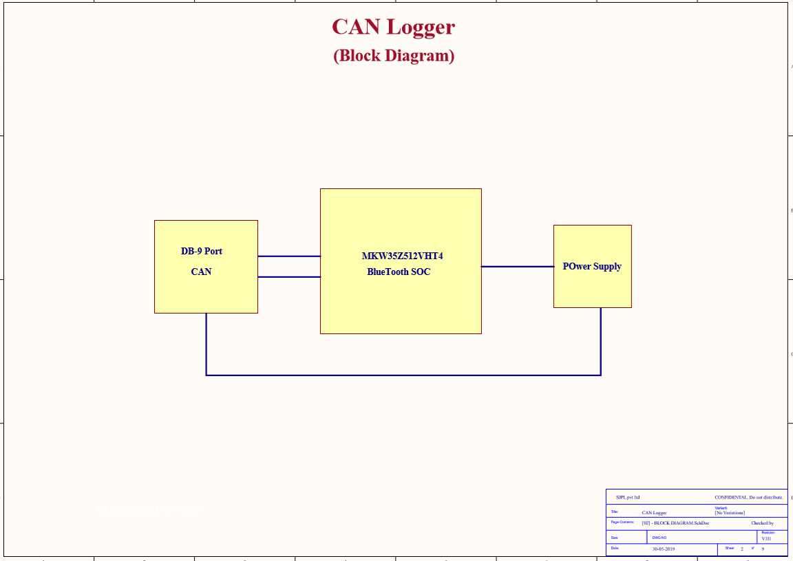

Slide 27
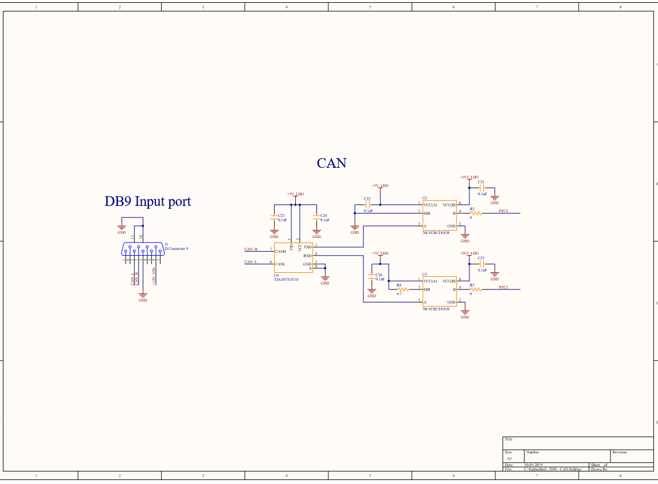

Slide 28
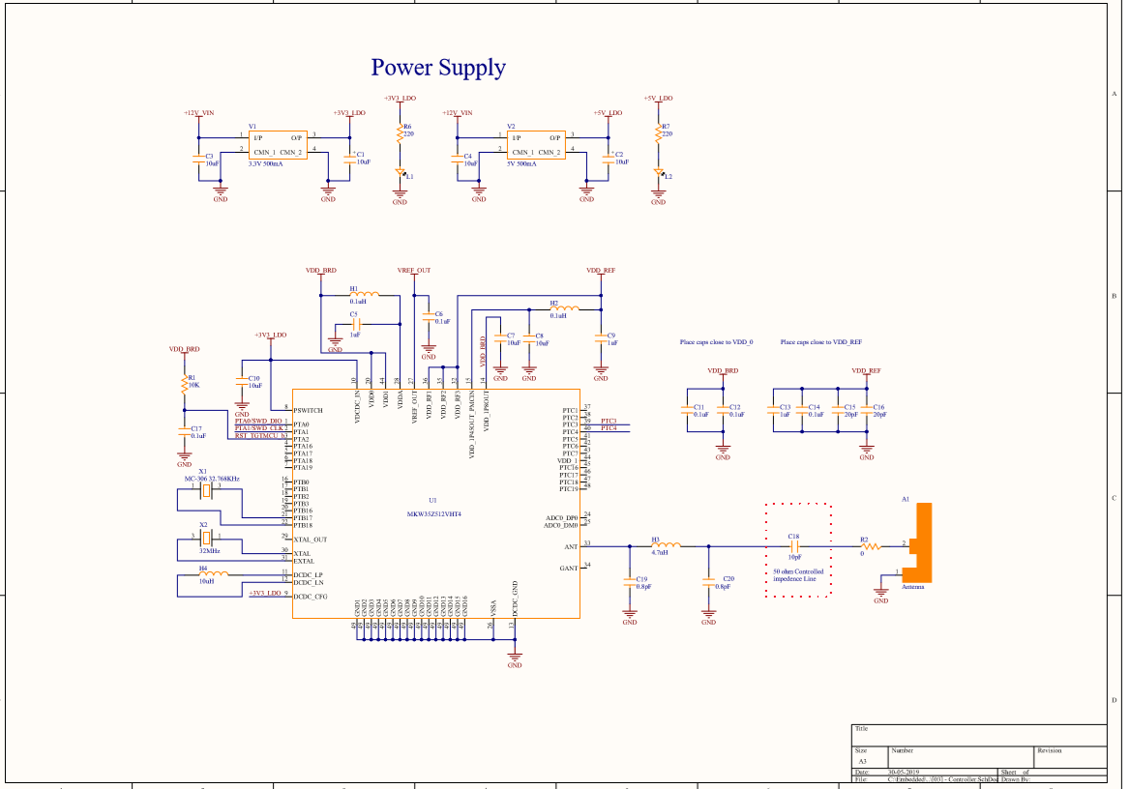

Slide 29
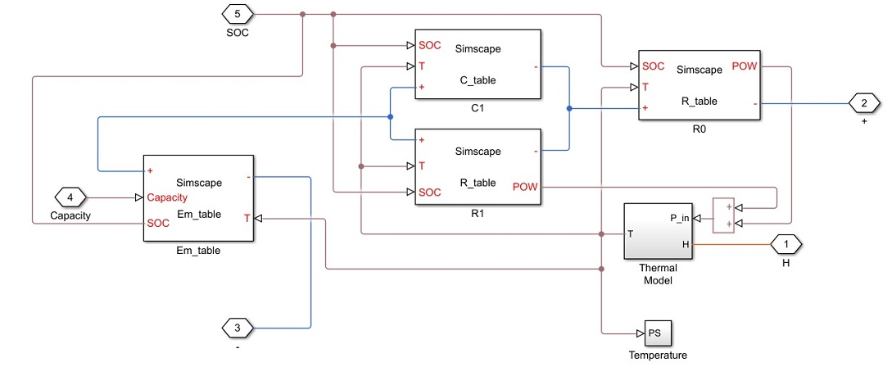
SoC Estimation Model

Slide 30
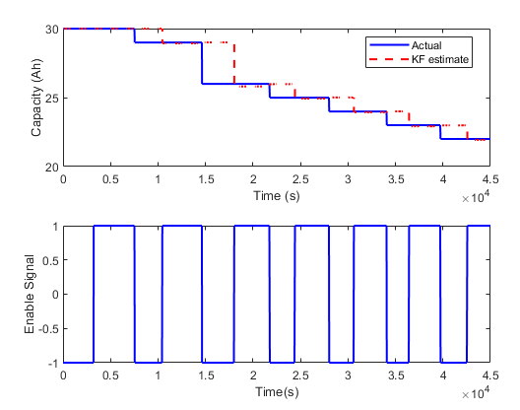
Simulink Data
In general, the Kalman Filter is able to track the real capacity.
There is half cycle delay between estimated capacity and real capacity.
This is because the battery capacity degradation happens when one full discharge-charge cycle ends. While the coulomb counting gives a capacity measurement of the last discharge or charge cycle.

Slide 31
Gaurav
Time series data
Data from BMS
Data from BMS
Driver ID (to identify BMS meta data & Car model)
Input Current
Input Voltage
Temperature
BMS load
Data from Filter for BMS without SoC Tracking
SoC Estimation
(To generate filter data)
Calibration data
State of charge (from Voltage, Input Current, Temperature of battery)
State of Life (Rate of change of SoC with BMS load parameters & Datasheet ground truth and calibration error)
Calibration delta (rate of change of calibration error)
Log of charge activity

Slide 32
Cross platform App
To access data from device
To access device location
To get user information
Push them all to server
Display analytics
Give battery charge info
Give battery life info
Navigation to EV Stations
And more …

Slide 33
Reward points for app usage
Exchangeable at EV Complex facilities
Exchangeable for replacement of battery at discounts
Incentivizing usage of data sharing policy
Incentivizing waste aggregation at EV complex
This can be better utilized for battery waste monitoring and mitigation through data.
Essentially transforming EV Complex in a complete solution.

Slide 34
Key Questions ?
What insights are most relevant ?
What data from Battery Management System (BMS) of EV matters?
How to calculate battery status ?
Zero charge
Threshold Charge limit
Recommended Charge limit
What is battery lifecycle ?
Calculation model
Average battery lifetime for present fleet
Fleet analytics
User profile
Location
Who needs what information the most ?
EESL
Consumers
Third parties
0. Mentors (Swati Sharma)
2. Adoption

Slide 35
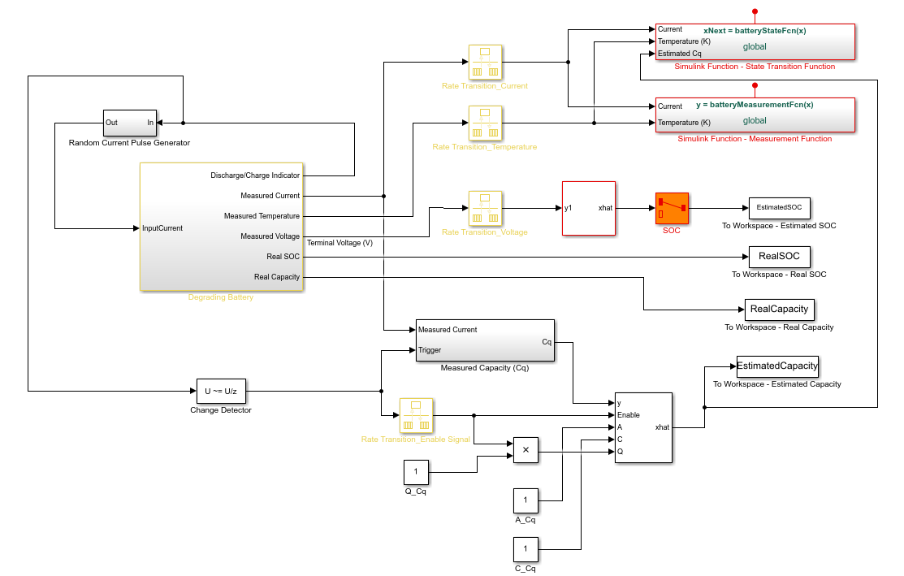
Battery Degradation Estimation Model (UKF)

Slide 36
Dwar
To drive analytics
Fleet monitoring
EV station placement
Position (Lat, Long)
Capacity & Distribution
Battery waste/lifecycle management
Dashboards & APIs for
EESL
Charging Stations
Analysts & Third Parties

Slide 37
Gaurav
Garuddwar
Technology Solution - Estimates

Slide 38
App
Insights
Analytics Engine
Display analytics
Give battery charge info
Give battery life info
Navigation to EV Stations
And more …
Dashboard
Insights
Fleet monitoring
EV station placement
Position (Lat, Long)
Capacity & Distribution
Battery waste/lifecycle management
BMS Logger
EVs
Data

Slide 39
Gaurav
Insights
Analytics Engine
The move targets the two highest selling categories in the Indian automotive market,
together counting to a total of over 2 crore units annually.
Source
Display analytics
Give battery charge info
Give battery life info
Navigation to EV Stations
And more …
Dwar
Insights
Fleet monitoring
EV station placement
Position (Lat, Long)
Capacity & Distribution
Battery waste/lifecycle management
Garud
EVs
Data

Slide 40
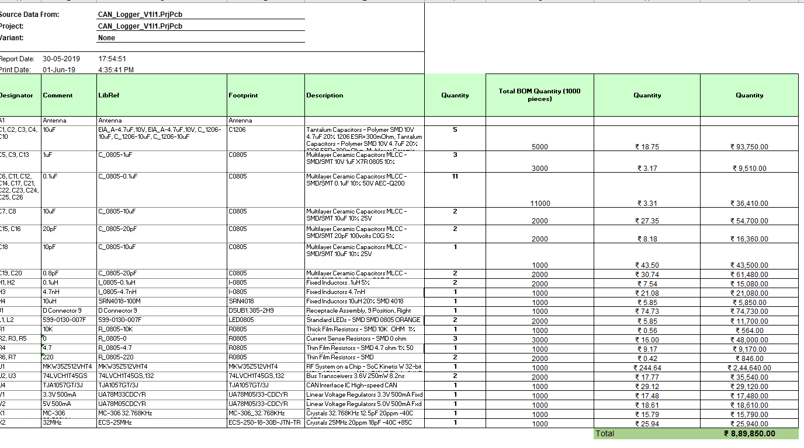
Prototype cost 1000 pieces to start field trials = 890/- INR per piece
Production deadline starting today = 12th of July 2019
Market Ready given 3 months of field trials = 2nd of November 2019

Slide 41
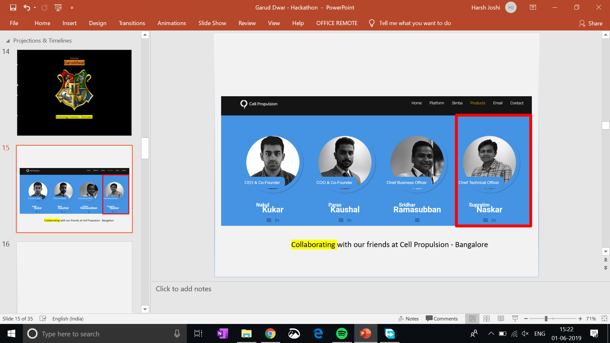
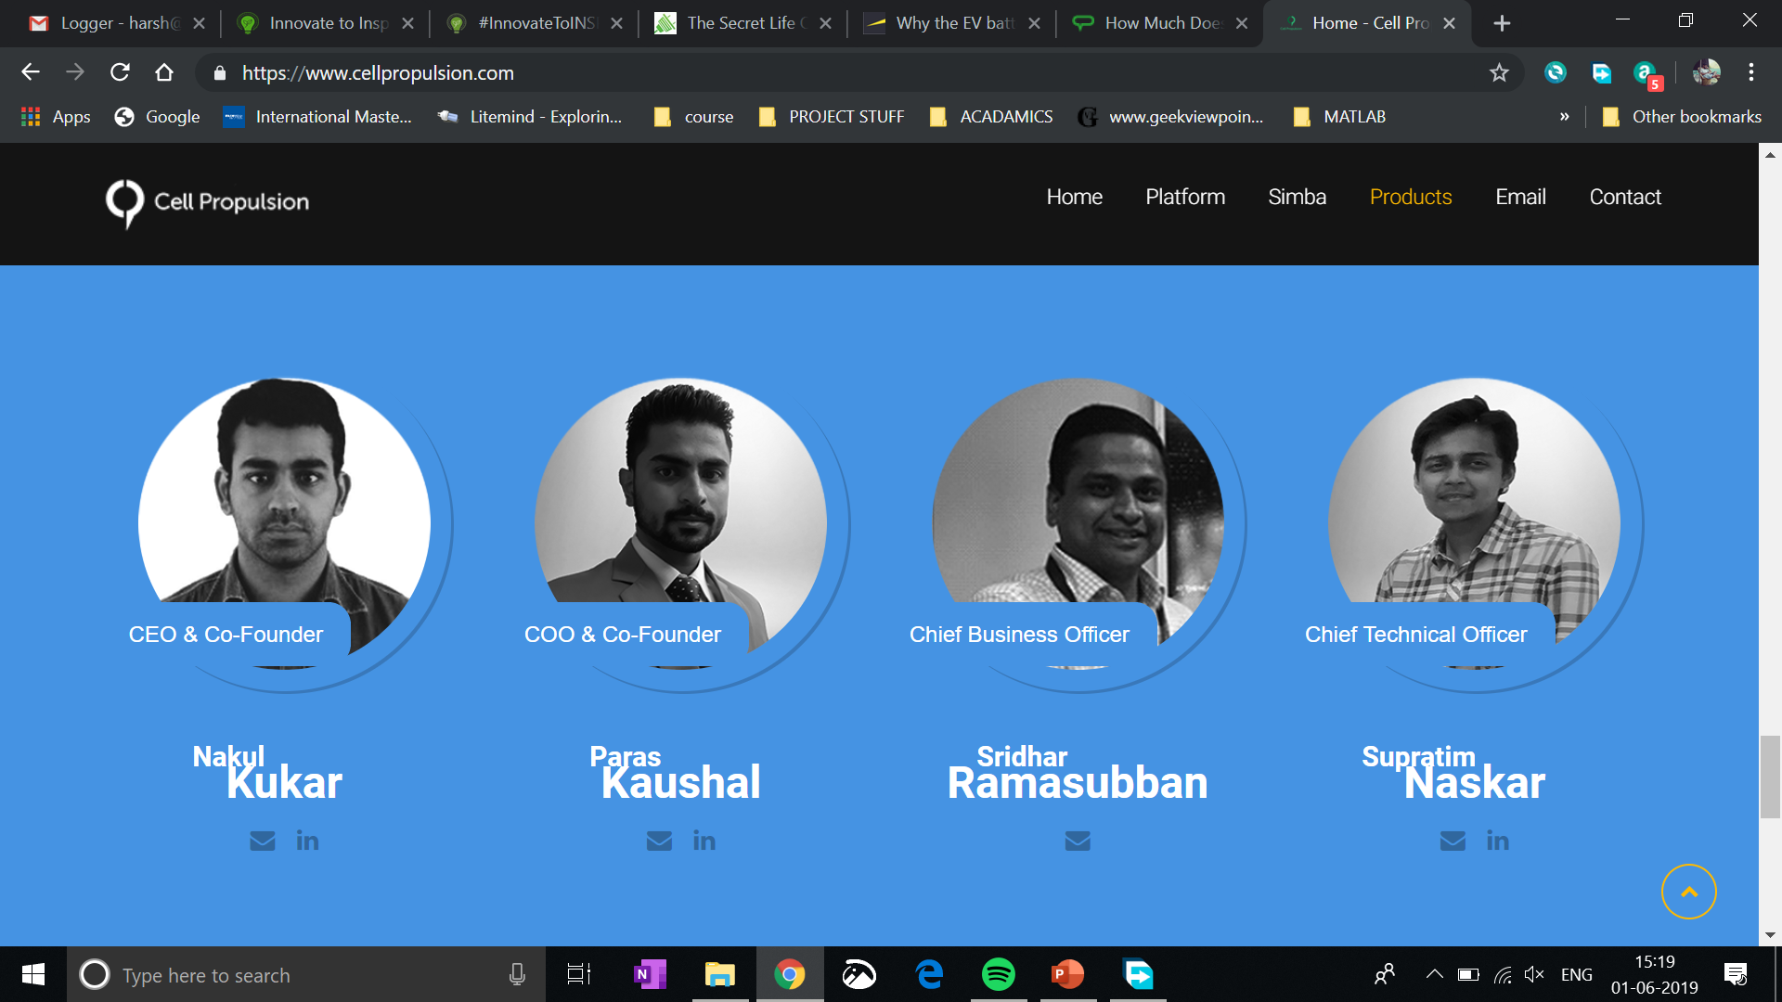
Collaborating with our friends at Cell Propulsion - Bangalore

Slide 42
Key Questions ?
What insights are most relevant ?
What data from Battery Management System (BMS) of EV matters?
How to calculate battery status ?
Zero charge
Threshold Charge limit
Recommended Charge limit
What is battery lifecycle ?
Calculation model
Average battery lifetime for present fleet
Fleet analytics
User profile
Location
Who needs what information the most ?
EESL
Consumers
Third parties
1. Data aggregation

Slide 43
Gaurav
Insights
USP to drive EV mobility sustainably
Analytics Engine
Display analytics
Give battery charge info
Give battery life info
Navigation to EV Stations
And more …
Dwar
Insights
Fleet monitoring
EV station placement
Position (Lat, Long)
Capacity & Distribution
Battery waste/lifecycle management
Garud
EVs
Data

Slide 44
Market Ready given 3 months of field trials = 2nd of November 2019

Slide 45
Market Ready given 3 months of field trials = 2nd of November 2019

Slide 46
Gaurav
Garuddwar
Business Solution

Slide 47
Gaurav
Insights
Analytics Engine
Option A : Strategic tie ups with EV distributors, manufacturers & BMS manufacturers to avail market penetration
Display analytics
Give battery charge info
Give battery life info
Navigation to EV Stations
And more …
Dwar
Insights
Fleet monitoring
EV station placement
Position (Lat, Long)
Capacity & Distribution
Battery waste/lifecycle management
Garud
EVs
Data

Slide 48
Gaurav
Insights
Analytics Engine
Option B : To sell it as standalone product. App reward model to incentivize the purchase of device.
Display analytics
Give battery charge info
Give battery life info
Navigation to EV Stations
And more …
Dwar
Insights
Fleet monitoring
EV station placement
Position (Lat, Long)
Capacity & Distribution
Battery waste/lifecycle management
Garud
EVs
Data

Slide 49
Gaurav
Insights
USP to drive EV mobility sustainably
Analytics Engine
Display analytics
Give battery charge info
Give battery life info
Navigation to EV Stations
And more …
Dwar
Insights
Fleet monitoring
EV station placement
Position (Lat, Long)
Capacity & Distribution
Battery waste/lifecycle management
Garud
EVs
Data
Option A : App based reward points, for exchange at EV complex for:
Facilities at Complex
Battery Replacements
Maintenance
Premiere rush in slot booking

Slide 50
Gaurav
Insights
USP to drive EV mobility sustainably
Analytics Engine
Display analytics
Give battery charge info
Give battery life info
Navigation to EV Stations
And more …
Dwar
Insights
Fleet monitoring
EV station placement
Position (Lat, Long)
Capacity & Distribution
Battery waste/lifecycle management
Garud
EVs
Data
Option B : Monetization avenue for utilizing our APIs & Datasets for analysts, third party developers and businesses; built around booming EV economy space in India.

Slide 51
Gaurav
Insights
USP to drive EV mobility sustainably
Analytics Engine
Display analytics
Give battery charge info
Give battery life info
Navigation to EV Stations
And more …
Dwar
Insights
Fleet monitoring
EV station placement
Position (Lat, Long)
Capacity & Distribution
Battery waste/lifecycle management
Garud
EVs
Data
Opportunity A : Focused and aggregated fleet analytics for EESL & third parties to plan EV Station commissioning & Planning

Slide 52
Gaurav
Insights
USP to drive EV mobility sustainably
Analytics Engine
Display analytics
Give battery charge info
Give battery life info
Navigation to EV Stations
And more …
Dwar
Insights
Fleet monitoring
EV station placement
Position (Lat, Long)
Capacity & Distribution
Battery waste/lifecycle management
Gaurav
EVs
Data
Opportunity B : By not charging developers for accessing data, they can strategically drive more entry comfort for App ecosystem, around the offering.

Slide 53
Gaurav
Garuddwar
Scalability Solution

Slide 54
To drive analytics
Fleet monitoring
EV station placement
Position (Lat, Long)
Capacity & Distribution
Battery waste/lifecycle management
Dashboards & APIs for
EESL
Charging Stations
Analysts & Third Parties

Slide 55


Swiggy's latest talks to raise about $200 million is expected to value the firm at about $1.3 billion, according to a person aware of the discussions. That would make it the fastest online firm to join India's unicorn club of companies estimated to be worth at least $1 billion.
Link
Forbes estimates his net worth to be at least $5.8 billion. Garrett Camp, Uber’s cofounder, owns a 6% stake according to the filing, which makes up the majority of his $4.6 billion net worth.
Link
App economy to grow to $6.3 trillion in 2021, user base to nearly double to 6.3 billion. The global app economy will be worth $6.3 trillion by 2021, up from $1.3 trillion last year, according to a new report this morning from app analytics firm App Annie.
Link

Slide 56
Swiggy's latest talks to raise about $200 million is expected to value the firm at about $1.3 billion, according to a person aware of the discussions. That would make it the fastest online firm to join India's unicorn club of companies estimated to be worth at least $1 billion.
Link
Forbes estimates his net worth to be at least $5.8 billion. Garrett Camp, Uber’s cofounder, owns a 6% stake according to the filing, which makes up the majority of his $4.6 billion net worth.
Link

Slide 57


Android OS
Android SDK
In the first quarter of 2016, about 84 percent of smartphones sold to end users used Android as its operating system. Android is expected to maintain its smartphone market share of about 85 percent up to 2020, while Apple's iOS is projected to account for 15 percent.
https://www.statista.com/statistics/236027/global-smartphone-os-market-share-of-android/
System Applications
GUI
Utility Applications

Slide 58
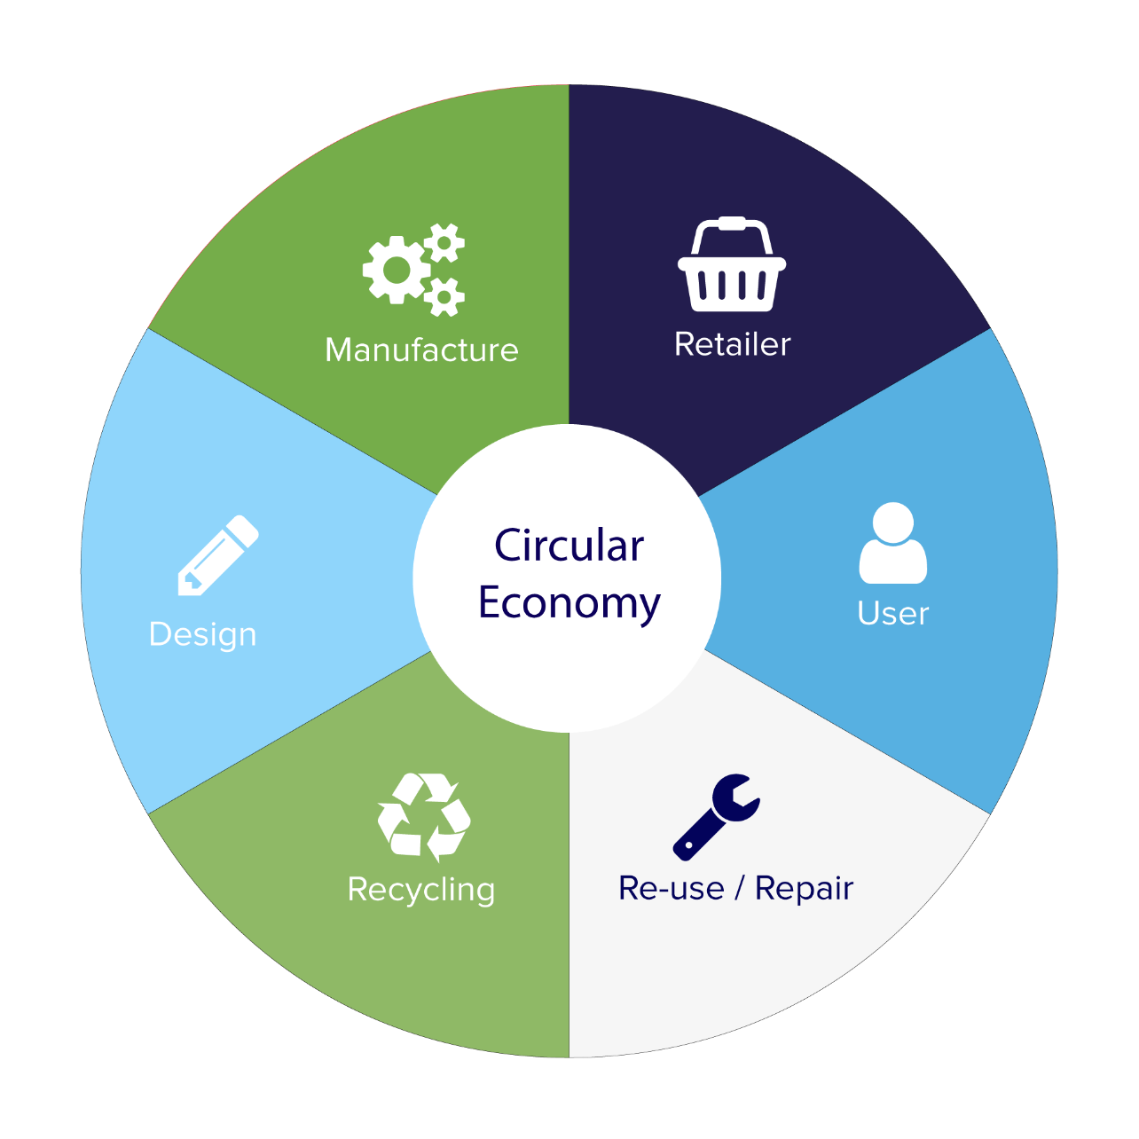
Gaurav
Garuddwar
Technology Solution

Slide 59
To drive analytics
Fleet monitoring
EV station placement
Position (Lat, Long)
Capacity & Distribution
Battery waste/lifecycle management
Dashboards & APIs for
EESL
Charging Stations
Analysts & Third Parties

Slide 60

Gaurav
Garuddwar
Technology Solution

Slide 62
1. Data aggregation
2. Adoption
3. Plumbing

Slide 63
The move targets the two highest selling categories in the Indian automotive market, together counting to a total of over 2 crore units annually.
Source

Slide 64
That’s our vison.
Vision 2030

Slide 65
It’s not just a problem that needs solving
It’s also a business opportunity
to shape the course of a sustainable & circular economy.

Slide 66
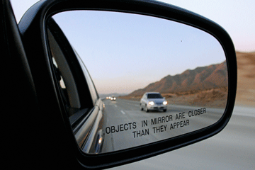
It’s about time we have a sustainable & circular economy.

Slide 67

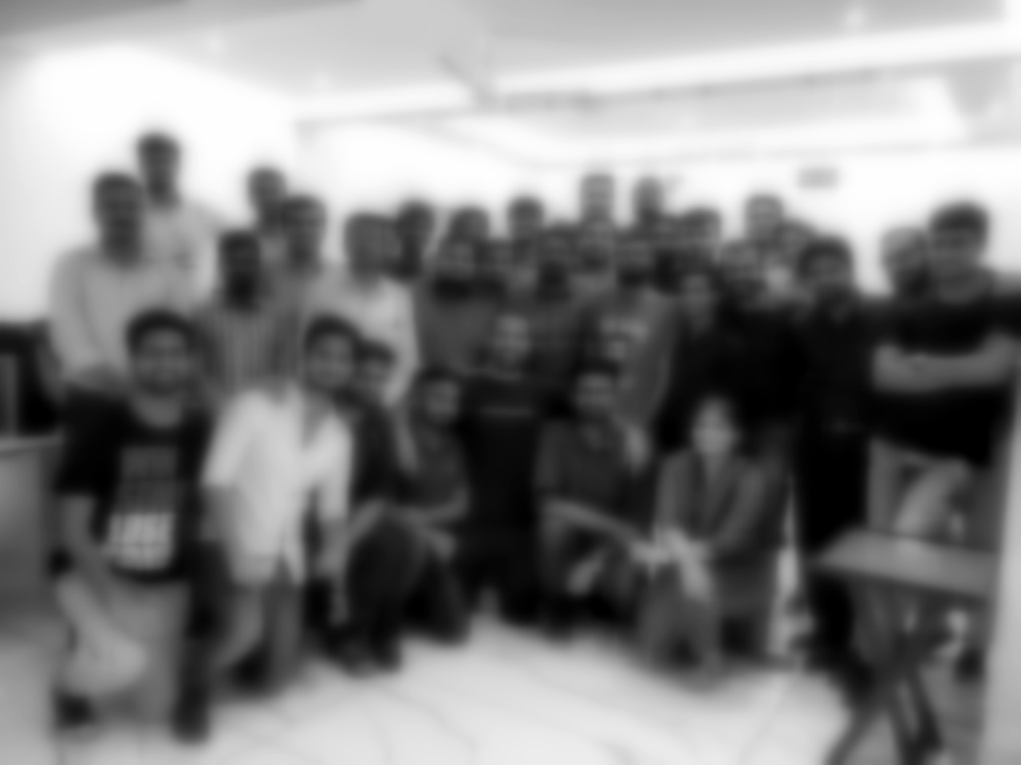


Slide 68
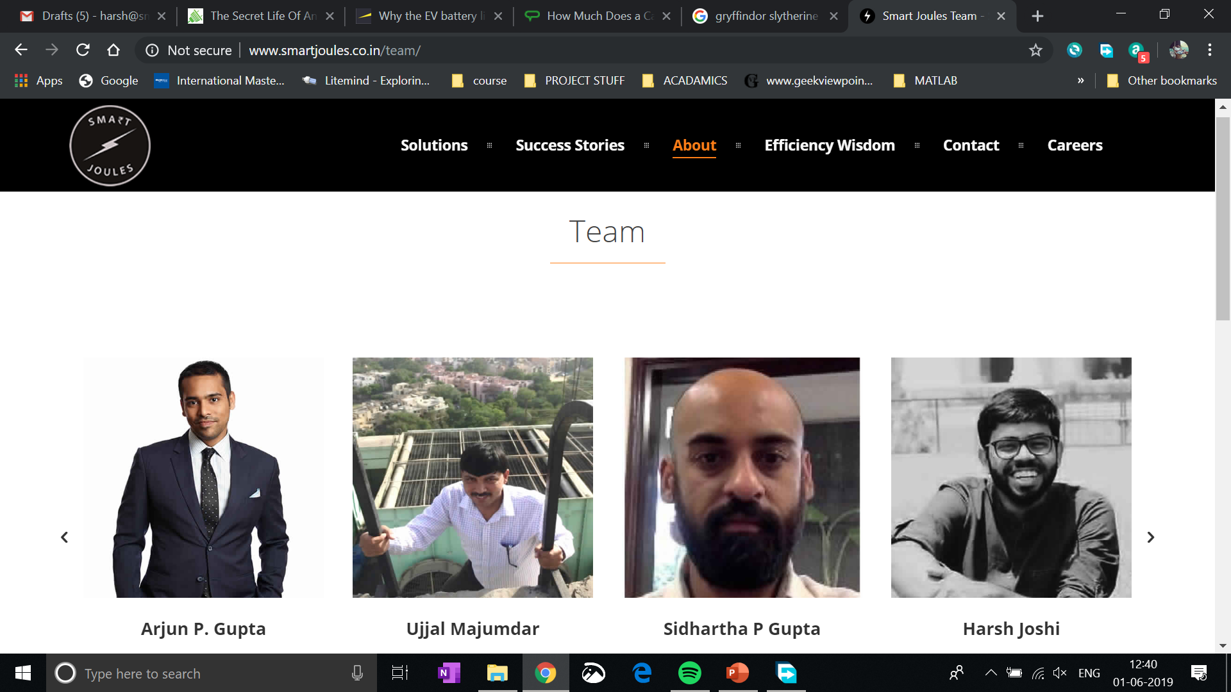
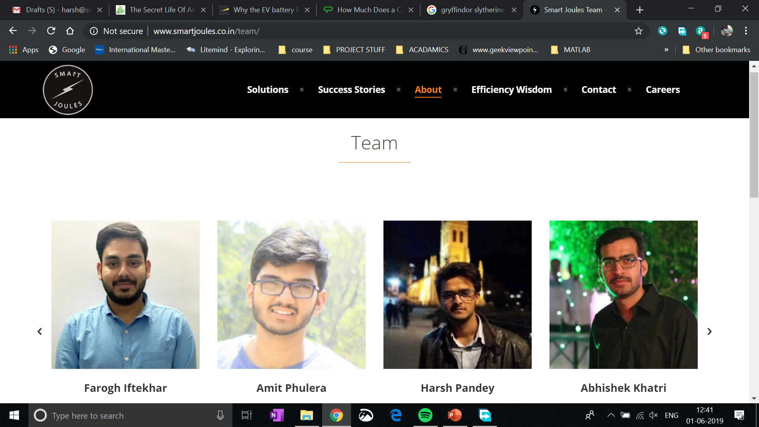

Slide 69
Gaurav
Garuddwar
It would be nice if we can make some friends along the way.
Will you help us shape a better future?.

Slide 70
Come join us, and together ….
We can create a sustainable future for this circular economy
info@smartjoules.in
www.smartjoules.co.in

Slide 71

info@smartjoules.in
www.smartjoules.co.in
Nagesh
Nagshakti
Gaurav
Garuddwar
Chandrika
Cheelghat

